Slide 1
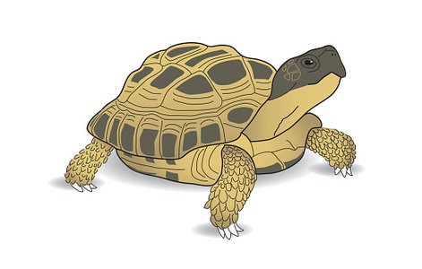
Story Starter: Merlin the Tortoise Misses His Best Friends

Slide 2
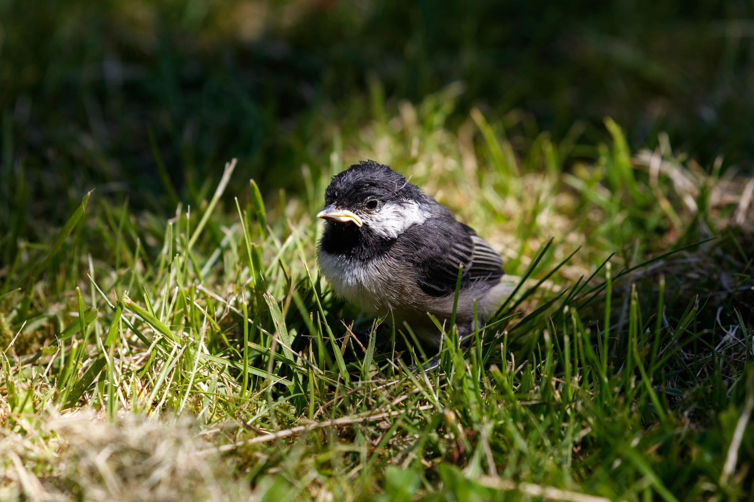
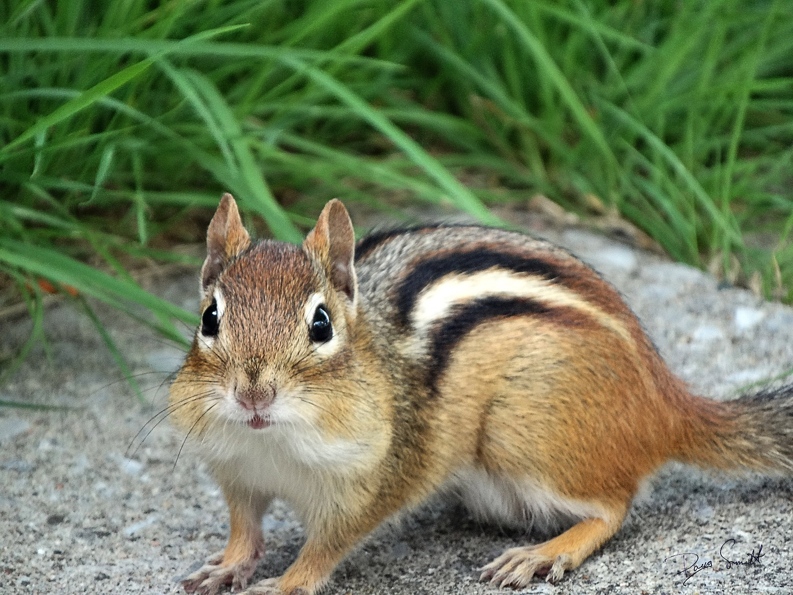
Merlin had been inside for weeks because it had been cold and raining. He was sad and missing his new friends Scarlet the chickadee and Henry the chipmunk.

Slide 3
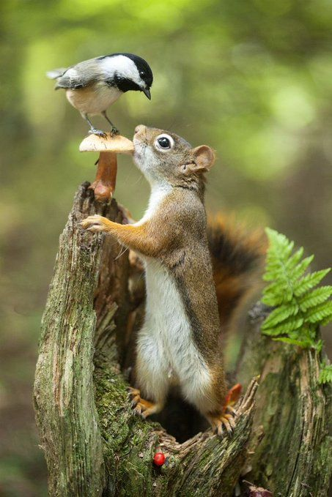
On the first warm, sunny day, Merlin’s family took him outside to enjoy the sun. Merlin immediately looked around for Scarlet and Henry. It didn’t take long for both friends to appear.

Slide 4
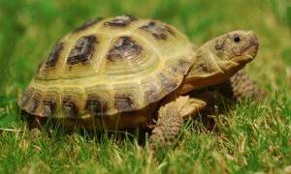
Merlin was overjoyed to see both of his friends! He quickly introduced Scarlet to Henry and told them how much he missed them! Merlin asked Scarlet and Henry what they wanted to do.

Slide 5
On the next few slides, continue writing this story and explain what Merlin, Scarlet and Henry decided to do.
Do the friends go on an adventure?
Do they meet any other animals along the way?
Add illustrations to help the reader envision the end of your story.

